Slide 1

ISPAH’s Eight Investments That Work for Physical Activity

Slide 2
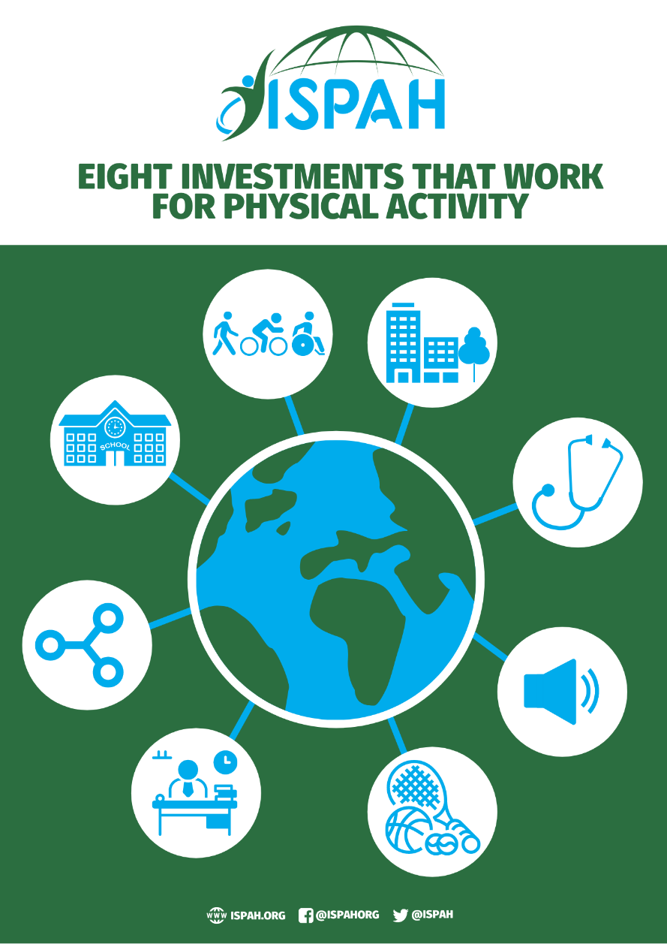
An overview of evidence which can be used to advocate, inform and lead physical activity policy and discussion.

Slide 3
Call to Action
A call to action for everyone, everywhere, including professionals, academics, civil society and decision makers to embed physical activity in national and subnational policies.

Slide 4
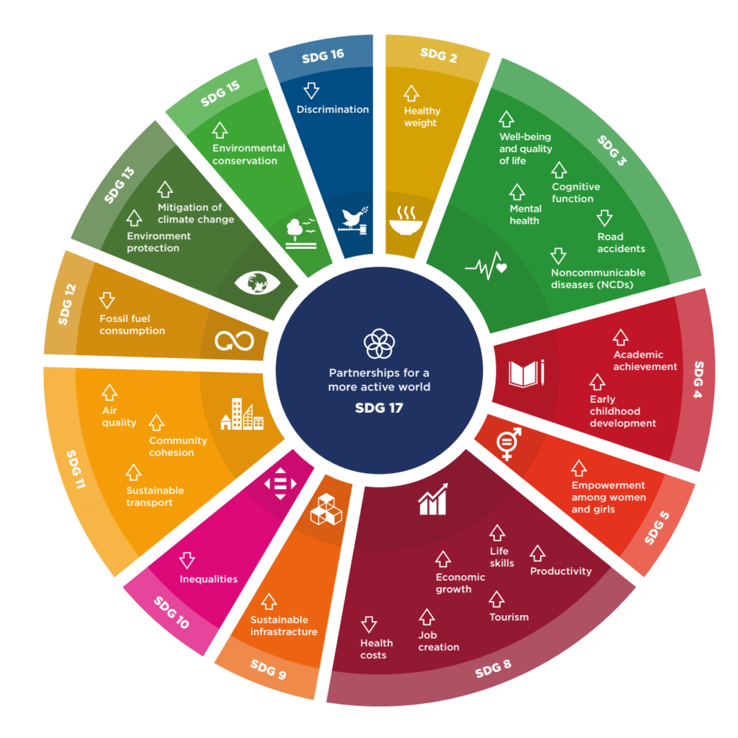
The many benefits of physical activity to individuals and society, including:
Health
Economic
Social
Environmental
Physical activity directly contributes to achieving 13 of the United Nations 2030 Sustainable Development Goals (SDGs)
Economic, social and environmental co-benefits of policy action to increase physical activity (taken from, Active: A Technical Package for Increasing Physical Activity).

Slide 5

Building on The GAPPA 2018-2030
The Global Action Plan for Physical Activity (2018-2030) (GAPPA) lays out four strategic objectives:
  Societies (social norms and attitudes)
  Environments (spaces and places)
  People (programmes and opportunities)
  Systems (governance and policy enablers)
ISPAH’s Eight Investments can be used in conjunction with the GAPPA to assist professionals and member states to respond to the current pandemic of inactivity

Slide 6
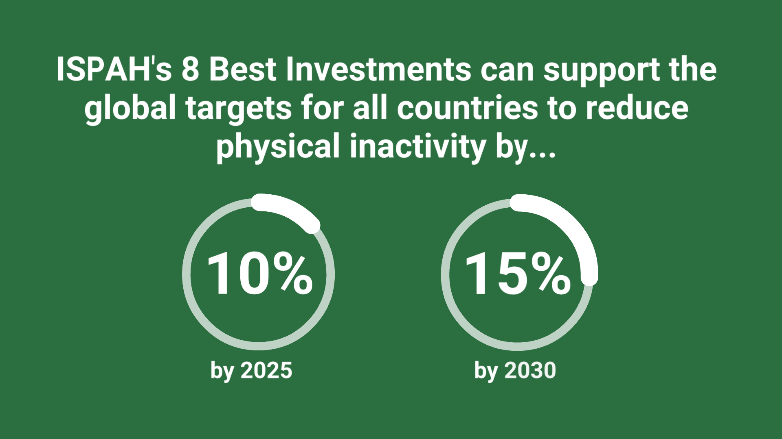
There is no single solution.
The crux of ISPAH’s Eight Investments is that no single investment should be expected to shift the needle on physical inactivity alone
Combinations of investments are required, taking a systems-based approach

Slide 7
Introducing each of:
ISPAH’s Eight Investments That Work for Physical Activity

Slide 8

1. Whole-of-School Programmes
✓
Engaging school communities
✓
Providing students with multiple physical activity opportunities
✓
Benefiting academic achievement & classroom behaviour

Slide 9

2. Active Travel
✓
Supportive transport policies
✓
Inducing demand for active travel
✓
Multiple co-benefits for the sustainable development goals

Slide 10

3. Active Urban Design
✓
Supportive and equitable policies
✓
Local amenities that create places for people
✓
Makes being active more appealing

Slide 11

4. Healthcare
✓
Physical activity promotion by health professionals
✓
Prevention of disease
✓
Management of disease

Slide 12

5. Public Education, Including Mass Media
✓
Transmitting clear messages
✓
Reaching large populations
✓
Raising awareness of physical activity’s importance

Slide 13

6. Sport and Recreation for All
✓
Equitable access to both formal and informal sport
✓
Across the lifespan
✓
Contributing to many of the Sustainable Development Goals

Slide 14

7. Workplaces
✓
Opportunities to be active embedded into the day
✓
Physical, mental and social benefits
✓
Reducing absenteeism and burnout

Slide 15

8. Community Wide Programmes
✓
Combining approaches to physical activity promotion
✓
Similar to a systems-based approach
✓
Co-benefits to society beyond health

Slide 16
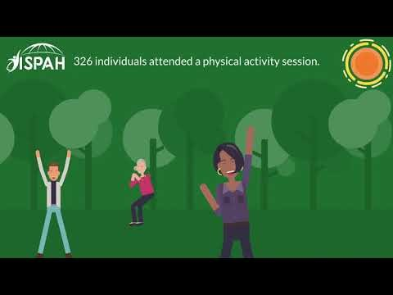
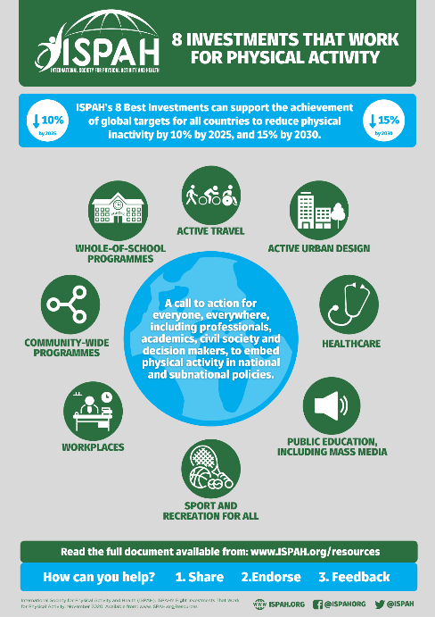



Additional Resources
Further resources: www.ispah.org/resources
Animation
Infographic
Audiobook and Podcasts
ISPAH (2020)
ISPAH (2020)
ISPAH 2020: International Society for Physical Activity and Health (ISPAH) 2020. Infographic, animation and call to Action. Eight Investments for physical activity. British Journal of Sports Medicine. XX(Y). Available from: www.dx.doi.org/XXXXXXXXXX

Slide 17
Advocacy tips
✓
Send to your colleagues
Distribute through your organisation
Send it to your boss and other decision makers
Build it into your dialogue with media
Share on social media #8Investments
✓
✓
✓
✓

Slide 18
How can you help?
1
The full document, infographic and animation
Share
Endorse
Feedback
2
As an individual or an organization
3
To info@ispah.org and on social media #8Investments

Slide 19


Slide 20


